Slide 1
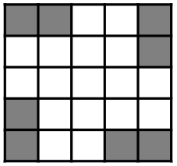
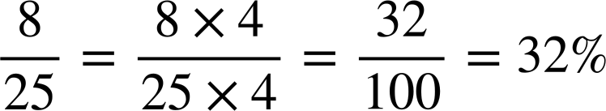
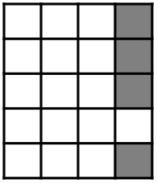
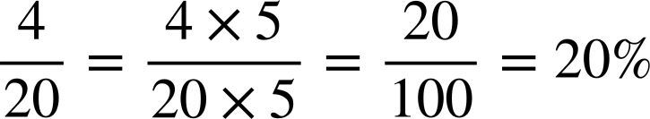
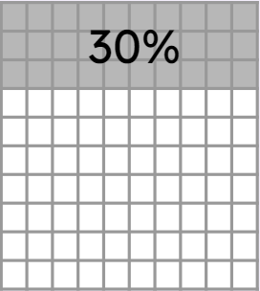
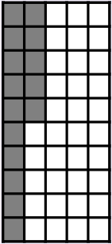
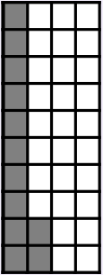


Checking understanding of percentages
Task A: Percentages, fractions and decimals
1) What proportion of the grid is shaded?
Give your answer as a percentage and a fraction.
2a) What proportion of the grid is shaded?
Give your answer as a percentage and a fraction.
2b) What percentage is shaded on the 100 grid on the right?
Shade the same percentage on grids A to G
15 squares shaded
12 squares shaded
B
A
C
D
3 blocks shaded
30% of 2 =
of a block shaded

Slide 2
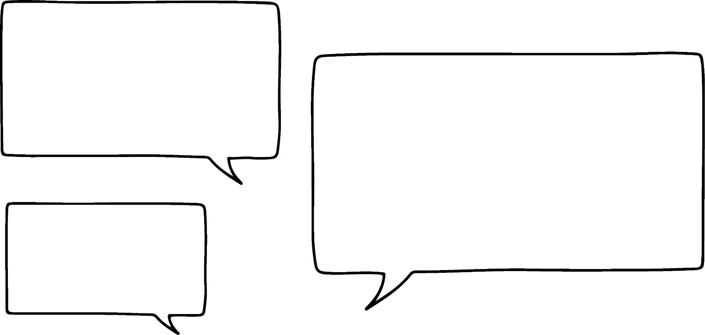



Checking understanding
Task B: Percentages of amounts
1) Work out the following:
20% of 640
30% of 520
c) 15% of 8
d) 35% of 30
10% of 640 = 640 ÷ 10 = 64
20% of 640 = 2 × 64 = 128
10% of 8 = 8 ÷ 10 = 0.8
5% of 8 = 0.8 ÷ 2 = 0.4
15% of 8 = 0.8 + 0.4 = 1.2
10% of 520 = 520 ÷ 10 = 52
30% of 520 = 3 × 52 = 156
10% of 30 = 30 ÷ 10 = 3
5% of 30 = 3 ÷ 2 = 1.5
35% of 30 = 3 × 3 + 1.5 = 10.5
2a) Who do you think is correct? Why?
2b) What percentages would the incorrect calculation(s) actually find?
Finding 20% of a number is easy. You just divide it by 20.
Finding 50% of a number is easy. You just divide it by 50.
Finding 10% of a number is easy. You just divide it by 10.
Aisha
Aisha is correct. Andeep - 20% is found by dividing by five. Izzy - 50% would be divide by two.
You may also try to exemplify your reasoning using a particular value, showing why dividing it by 20 would not result in 20% or 50% of that number.
Andeep
Izzy
Izzy would have found 2%.
Andeep would have found 5%

Slide 3
Checking understanding of percentages
3) Below are six students’ different strategies for finding 75% of 250. One of them is incorrect.
Whose strategy is incorrect?
Explain the method used by each pupil.
Found 1% then multiplied by 75 to give 75%
Andeep
250 ÷ 100 = 2.5
2.5 × 75 = __
Aisha
250 ÷ 2 = 125
125 ÷ 2 = 62.5
125 + 62.5 = __
Found 50% then found 25% and summed to make 75%
Found 10% then multiplied by 7 to give 70% then found 5% and summed to make 75%
Sofia
250 ÷ 10 = 25
25 × 7 = 175
25÷ 2 = 12.5
175 + 12.5 = __
Jacob
250 ÷ 4 = 62.5
250 - 62.5 = __
Found 25% then subtracted from 100% to make 75%
Sam
250 ÷ 4 = 62.5
62.5 × 3 = __
Lucas is incorrect
Lucas
250 ÷ 75 = __
Found 25% then multiplied by 3 to make 75%
Mathematics in Education and Industry.
v2.3

